Slide 1


K. RAMAKRISHNAN COLLEGE OF ENGINEERING
(Autonomous)
DEPARTMENT OF ECE
ECC1361 – INDUSTRIAL ELECTRONICS AND APPLICATIONS(PRBL)
III year / V sem
TITLE : AUTOMATED CABLE FAULT MONITORING SYSTEM
BATCH – 4
FINAL REVIEW
GUIDED BY,
Dr. V. BRINDA.,M.Tech.,Ph.D.,
ASSISTANT PROFESSOR, ECE
PRESENTED BY,
SHAHIN ASHIKA K - 8115U23EC097
SRI AMIRTHA VARSHINI SV - 8115U23EC108
SRI VIDHYA B - 8115U23EC110
16/12/25

Slide 2
CONTENTS
Introduction
Objective
Proposed system
Components and Cost estimation
Block diagram
Circuit Diagram
Working principle
Components Explanation
Output
Result and Discussion
Future Enhancements
Applications
Conclusion
References
16/12/25

Slide 3
ABSTRACT
This project presents an Underground Cable Fault Detection System designed to identify and locate faults in underground power cables efficiently. The system continuously monitors voltage variations using sensors and a microcontroller to detect fault conditions. Upon fault occurrence, the approximate distance of the fault is calculated, enabling quick and accurate maintenance. An IoT module is integrated to provide real-time alerts and remote monitoring. The automated approach eliminates the need for manual inspection, improving safety and reliability. Experimental results demonstrate accurate fault detection with minimal response time. The system reduces downtime, maintenance cost, and manpower requirements. Overall, the proposed system offers a smart, cost-effective, and scalable solution for modern power distribution networks.
16/12/25

Slide 4
INTRODUCTION
Underground power cables are widely used due to their safety, reliability, and reduced environmental impact. However, locating faults in underground cables is difficult and time-consuming using traditional methods. This project introduces an Underground Cable Fault Detection System to overcome these challenges. The system detects faults by monitoring voltage variations along the cable. It helps in quickly identifying fault locations, reducing downtime and maintenance effort.
16/12/25

Slide 5
PROPOSED SYSTEM
The proposed system provides an automated solution for detecting faults in underground power cables. It continuously monitors voltage levels along the cable using sensing circuits. A microcontroller analyzes the voltage variations to accurately identify different types of faults. Once a fault is detected, the system calculates the approximate distance of the fault from the source end. An IoT module is integrated to transmit real-time fault alerts to a remote monitoring platform. The system displays fault status and distance information for quick maintenance decisions. This approach reduces downtime, enhances safety, and improves the overall reliability of underground power distribution networks.
16/12/25

Slide 6
COMPONENTS AND COST ESTIMATION
Arduino UNO Microcontroller
Wi-fi Module(ESP8266)
Relay
LCD Display
Crystal Oscillator
Resistors
Capacitors
Transistors
Cables and Connectors
Diodes
PCB and Breadboards
LED
Transformer/Adapter
Push Buttons
Switch & current sensors
IC
16/12/25

Slide 7
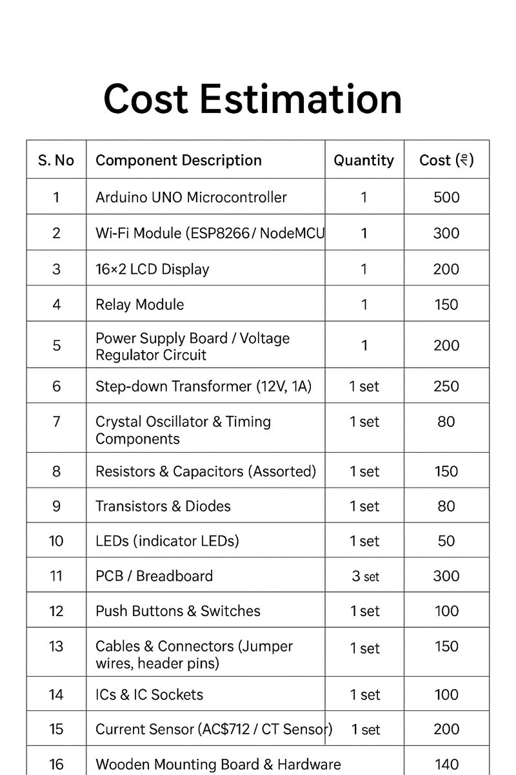
COMPONENTS AND COST ESTIMATION
TOTAL:2950
16/12/25

Slide 8
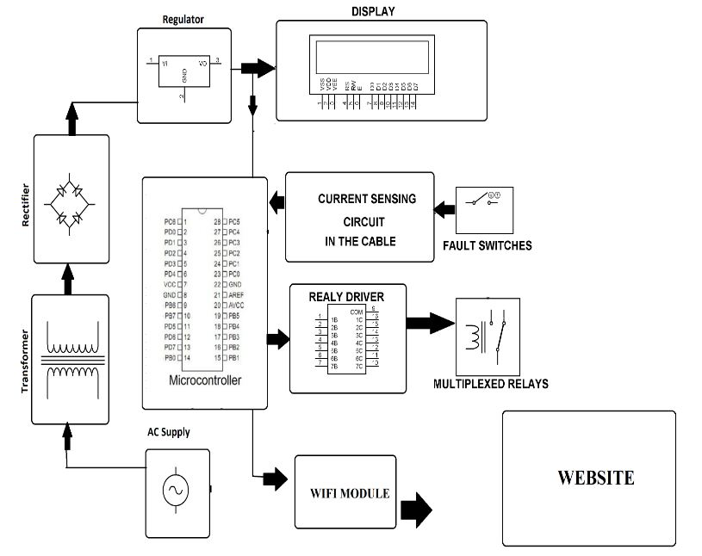
BLOCK DIAGRAM
16/12/25

Slide 9
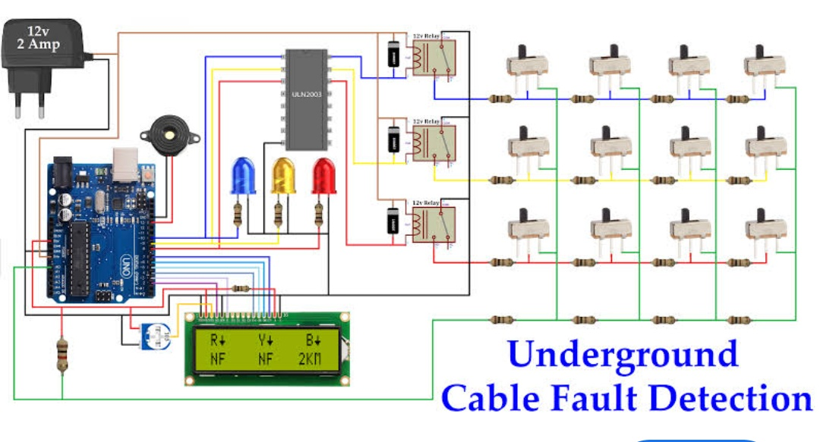
CIRCUIT DIAGRAM
16/12/25

Slide 10
WORKING PRINCIPLE
The system operates based on Ohm’s Law to detect changes in cable resistance.
A DC supply is applied to the underground cable through known resistors.
Any fault in the cable causes a change in resistance and voltage drop.
The current/voltage sensor detects this variation at the fault point.
The sensed signal is processed by the microcontroller .
The fault distance and type are calculated and shown on the LCD.
Fault details are sent to the IoT cloud via Wi-Fi for remote monitoring.
16/12/25

Slide 11
COMPONENTS EXPLANATION
Working Principle:
The transformer steps down 230V AC to low-voltage AC.
Diodes convert AC into DC supply.
Capacitors smooth the DC voltage and remove ripples.
Voltage regulators provide stable 5V and 3.3V outputs.
Resistors limit current and form voltage divider networks.
LEDs indicate power and system status.
The crystal oscillator supplies a stable clock signal to the microcontroller.
16/12/25

Slide 12
COMPONENTS EXPLANATION
COMPONENTS
Arduino UNO / ATmega Microcontroller, ICs, IC Sockets
WORKING PRINCIPLE:
The microcontroller acts as the central controller of the system.
It receives analog signals from the sensor through ADC channels.
Processes data to determine fault type and fault distance.
Generates control signals for LCD, relay, and Wi-Fi module.
IC sockets allow easy replacement and reliable mounting of ICs.
16/12/25

Slide 13
COMPONENTS EXPLANATION
COMPONENTS:
Current Sensors, Relay Module, Transistors
WORKING PRINCIPLE:
The current sensor continuously monitors current flow in the cable.
Any abnormal current indicates a short or open circuit fault.
Sensor output is converted into a proportional voltage.
Transistors amplify control signals from the microcontroller.
The relay isolates the faulty cable section to prevent damage.
16/12/25

Slide 14
COMPONENTS EXPLANATION
COMPONENTS:
16×2 LCD Display, Wi-Fi Module (ESP8266), Push Buttons, Switches, PCB, Breadboard, Cables & Connectors
WORKING PRINCIPLE:
The LCD displays fault location, distance, and system status.
The Wi-Fi module sends fault data to the IoT cloud/mobile app.
Push buttons and switches allow manual control and reset.
PCB and breadboard provide structured circuit layout.
Cables and connectors ensure reliable signal and power connections.
16/12/25

Slide 15
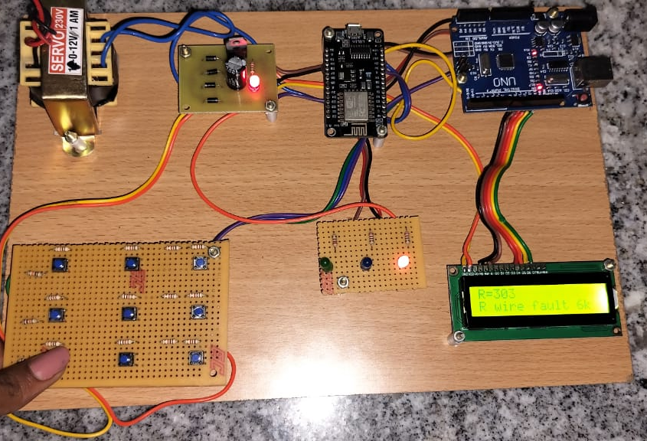
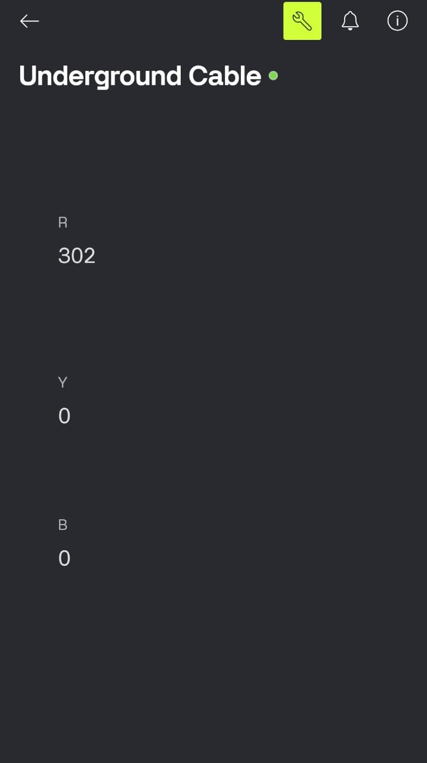
OUTPUT
16/12/25

Slide 16
RESULT AND DISCUSSION
RESULT:
The system accurately detected underground cable faults during testing under various fault conditions.
Fault distance estimation was found to be consistent and close to the actual fault location.
IoT-based alerts were successfully triggered in real time, enabling quick fault notification
DISCUSSION:
Performance Analysis: The system demonstrated stable and reliable operation during testing, accurately identifying fault conditions in underground cables.
Efficiency Improvement: Automated fault detection and distance estimation reduced manual effort and significantly minimized repair time.
Practical Applicability: The low-cost, compact design and IoT capability make the system suitable for real-time implementation in power distribution networks.
16/12/25

Slide 17
FUTURE ENHANCEMENTS
IoT-Based Advanced Monitoring: The system can be enhanced with cloud-based dashboards for real-time analytics, remote diagnostics, and historical fault data storage.
Improved Fault Classification: Advanced algorithms or machine learning techniques can be added to differentiate between temporary, permanent, and high-impedance faults.
Multi-Cable Monitoring: Future versions can support monitoring of multiple underground cables simultaneously using a single control unit.
Compact PCB and Safety Upgrades: Designing a custom PCB with improved insulation and protection circuits can enhance reliability, safety, and long-term performance.
16/12/25

Slide 18
APPLICATIONS
Used in underground power distribution systems to quickly detect and locate cable faults.
Helps electricity boards and utility companies reduce power outage duration.
Applicable in industrial plants for monitoring underground power cables.
Useful in smart city infrastructure for reliable power management.
Enhances safety by minimizing manual inspection of underground cables.
Supports preventive maintenance and improves overall system reliability.
16/12/25

Slide 19
CONCLUSION
The Underground Cable Fault Detector system was successfully designed and implemented to identify faults in power cables. The system accurately detects fault conditions and estimates the fault distance using voltage sensing techniques. IoT integration enables real-time monitoring and instant alerts, reducing response time. The automated approach minimizes manual inspection and improves safety for maintenance personnel. Experimental results confirm reliable performance and quick fault identification. The system is cost-effective, easy to implement, and scalable. Overall, it provides an efficient solution for improving reliability in underground power distribution networks.
16/12/25

Slide 20


